Slide 1
Analyzing Lacoma Neighborhood
Patricia Pérez

Slide 2
New restaurants opportunities due to Covid-19
Due to the Covid-19 crisis, many businesses have had to close
Starting a new business is a way to revive the economy
Opnening new resturants brings the neighborhood back to life
Factor that will influence our decision of opening a restaurant are:
number of existing restaurants in the neighborhood (any type of restaurant)
number of and distance to different sports centers in the neighborhood, if any

Slide 3
Data acquisition and cleaning
Sources from IBM Data Science Professional Certificate courses
Places: https://developer.foursquare.com/
Raw data set contains 33 places
Cleaned data contains
11 restaurants
7 bars
4 sport centers

Slide 4
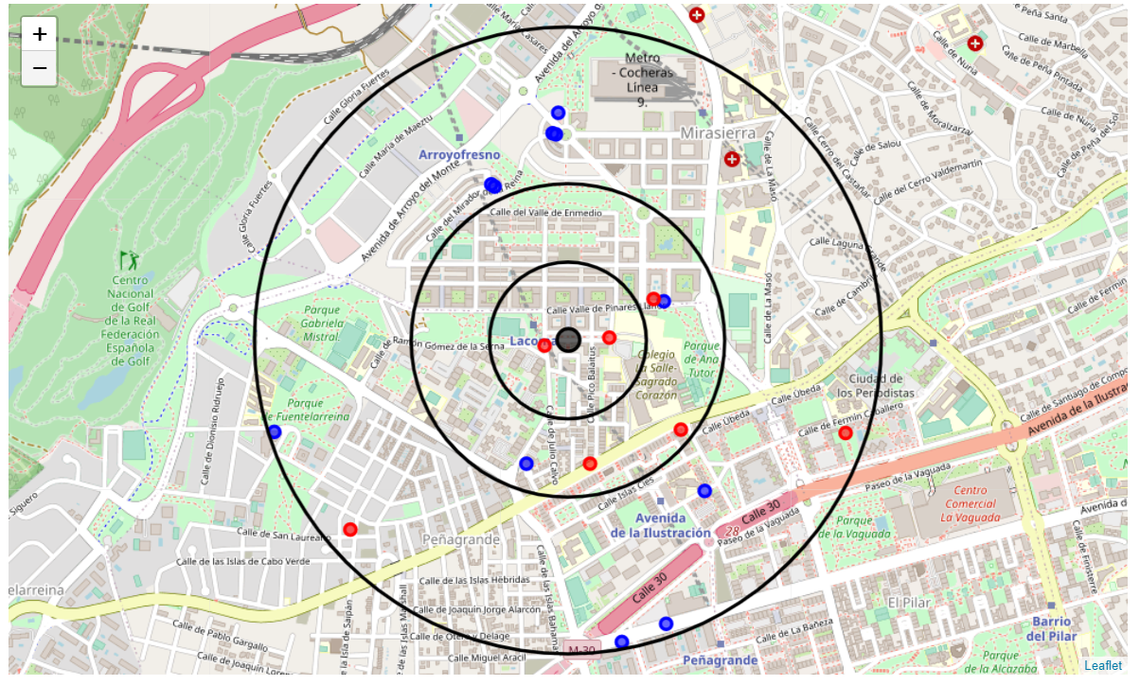
Restaurants (blue) and Bars (red)

Slide 5
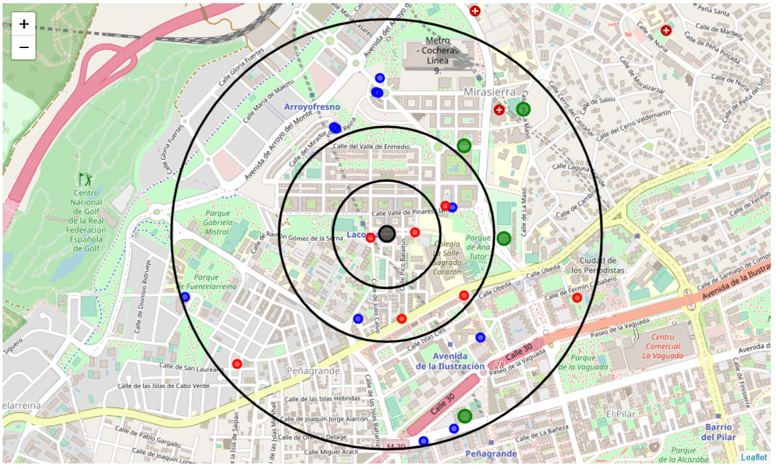
Restaurants (blue), Bars (red) and Sport Centers (green)
There is an area with low density of food places and high density of sport places: MIRASIERRA

Slide 6
Conclusion
The north and the south have high concentration of restaurants
There are two areas with low food places density: PEÑAGRANDE and MIRASIERRA
MIRASIERRA has also high density of sport places, which are a good claim

